Slide 1



Spotify Data Analysis

Slide 2

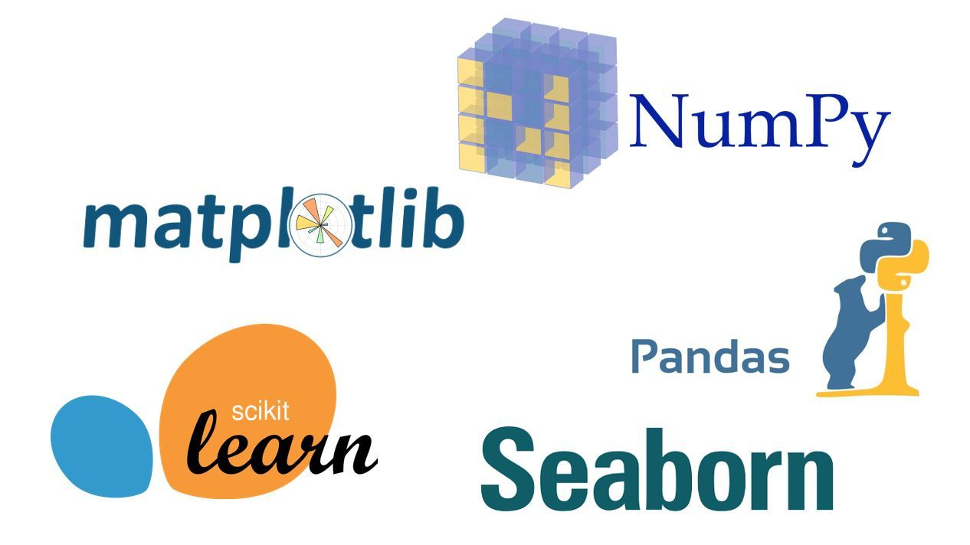
Project Synopsis
Spotify is a Swedish audio streaming and media services provider , launched in October 2008. Users can search for music based on artist, album, or genre, and can create, edit, and share playlists.
Goal – Explore Spotify’s song data to get current trend and predict popularity of songs.
Also, we aim to use various libraries of Python like pandas, matplotlib, numpy to read given data, visualize, plot the trends in the data. Further, to predict the popularity of songs, we will be importing sklearn libraries for Data Modelling & Normalization, Linear model, Lasso, XGBRegressor and KNN to build models. We’ll also be importing the randint library to generate random numbers.

Slide 3


Data Description
Data Source – Data used in the project has been collected from Spotify Web API and the data is grouped by artists, year and genres.
Primary:
- id (Id of track generated by Spotify)
Numerical:
- acousticness (Ranges from 0 to 1)
- danceability (Ranges from 0 to 1)
- energy (Ranges from 0 to 1)
- duration_ms (Integer typically ranging from 200k to 300k)
- instrumentalness (Ranges from 0 to 1)
- valence (Ranges from 0 to 1)
- popularity (Ranges from 0 to 100)
- tempo (Float typically ranging from 50 to 150)
- liveness (Ranges from 0 to 1)
- loudness (Float typically ranging from -60 to 0)
- speechiness (Ranges from 0 to 1)
- year (Ranges from 1921 to 2020)
Dummy:
- mode (0 = Minor, 1 = Major)
- explicit (0 = No explicit content, 1 = Explicit content)
Categorical:
- - key (All keys on octave encoded as values ranging from 0 to 11, starting on C as 0, C# as 1 and so on…)
- artists (List of artists mentioned)
- release_date (Date of release mostly in yyyy-mm-dd format, however precision of date may vary)
- name (Name of the song)

Slide 4
Feature Definition
Column Name | Description
Valence | The Positiveness Of The Track. Higher Values Mean, The Track Evokes Positive Emotions (Like Joy) Otherwise Means, It Evokes Negative Emotions (Like Anger, Fear). Ranges Between 0-1.
Year | The Release Year Of The Track.
Acousticness | The Value That Describes How Acoustic A Song Is. Higher Values Mean That The Song Is Most Likely To Be An Acoustic One. Ranges Between 0-1.
Artists | The List Of Artists Credited For The Production Of The Track.
Danceability | The Relative Measurement Of The Track Being Danceable. Higher Values Mean That The Song Is More Danceable. Ranges Between 0-1.
Duration | The Length Of The Track. In Milliseconds.
Energy | The Energy Value Of The Track. Higher Values Mean That The Song Is More Energetic. Ranges Between 0-1.
Explicit | The Binary Value Whether The Track Contains Explicit Content Or Not.
Id | The Primary Identifier For The Track, Generated By Spotify
Instrumentalness | The Relative Ratio Of The Track Being Instrumental. Higher Values Mean That The Song Contains More Instrumental Sounds. Ranges Between 0-1.
Key | All Keys On Octave Encoded As Values Ranging From 0 To 11, Starting On C As 0, C# As 1, Etc.
Liveness | Detects The Presence Of An Audience In The Recording. Higher Values Represent An Increased Probability That The Track Was Performed Live. A Value Above 0.8 Provides A Strong Likelihood That The Track Is Live. Ranges Between 0-1.
Loudness | The Overall Loudness Of A Track In Decibels (Db). Loudness Values Are Averaged Across The Entire Track And Are Useful For Comparing The Relative Loudness Of Tracks. Loudness Is The Quality Of A Sound That Is The Primary Psychological Correlate Of Physical Strength (Amplitude). Values Typical Range Between -60 And 0 Db.
Mode | Mode Indicates The Modality (Major Or Minor) Of A Track, The Type Of Scale From Which Its Melodic Content Is Derived. Major Is Represented By 1 And Minor Is 0.
Name | The Name Of The Song.
Popularity | The Popularity Of The Song. Ranges Between 0 And 100.
Release Date | The Date Of Release Of The Track In Yyyy-Mm-Dd, Yyyy-Mm, Or Even Yyyy Format
Speechiness | The Relative Length Of The Track Containing Any Kind Of Human Voice. Ranged Between 0-1.
Tempo | The Tempo Of The Track In Beat Per Minute (Bpm)

Slide 5
Exploratory Data Analysis
Song Prediction System
Q&A

Slide 6
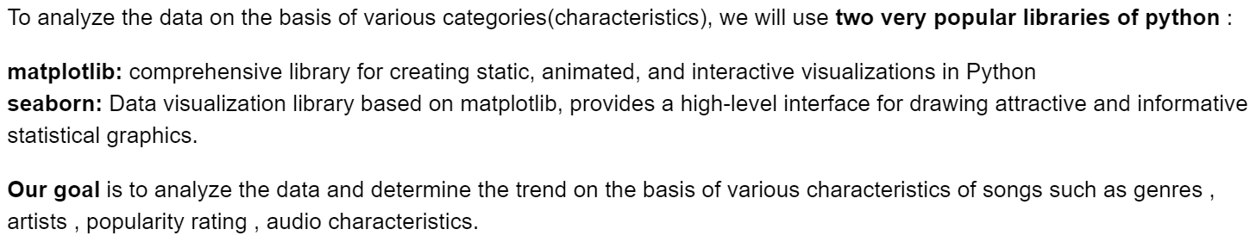
Exploratory Data Analysis

Slide 7
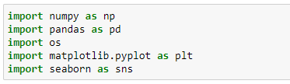
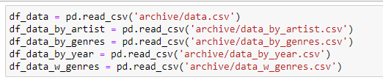
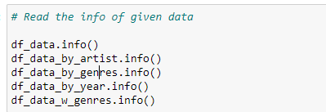
Importing essential Libraries
Reading the data
Beginning analysis of data

Slide 8
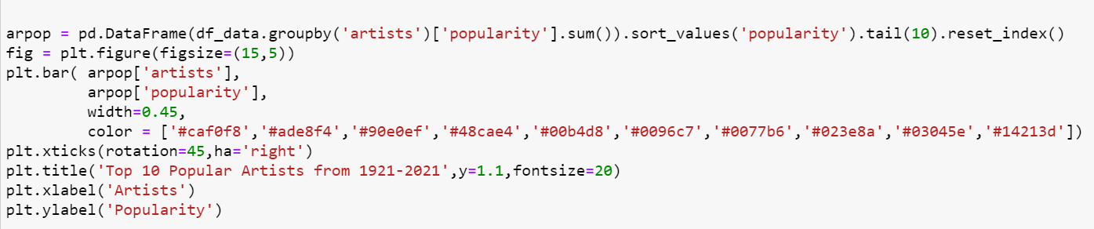
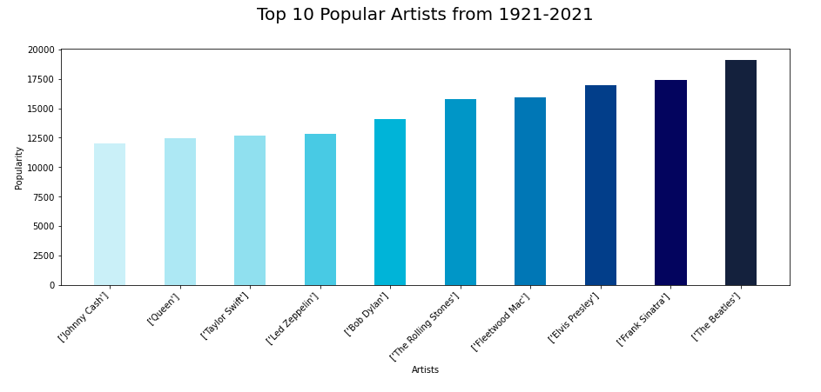
Top 10 Popular Artists from 1920 - 2021
Artists from 60s - 70s like Beatles , Elvis Presley , Frank Sinatra continue to rule the popularity charts

Slide 9

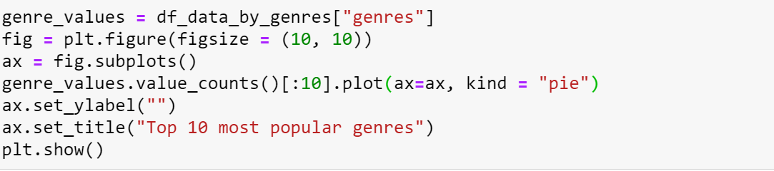
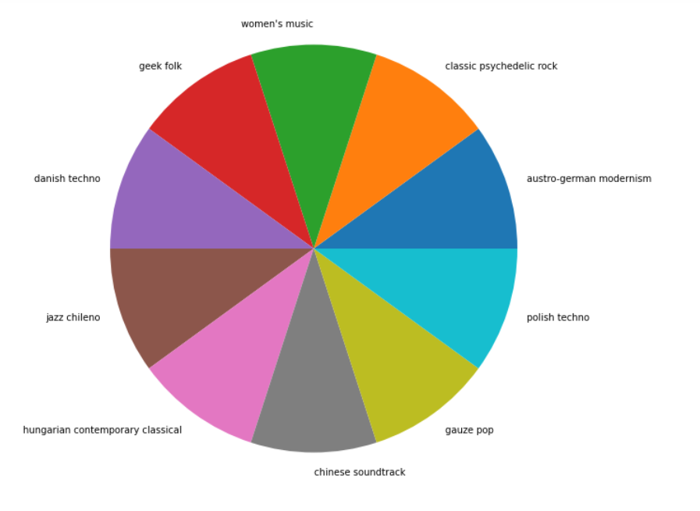
Top 10 Genres

Slide 10
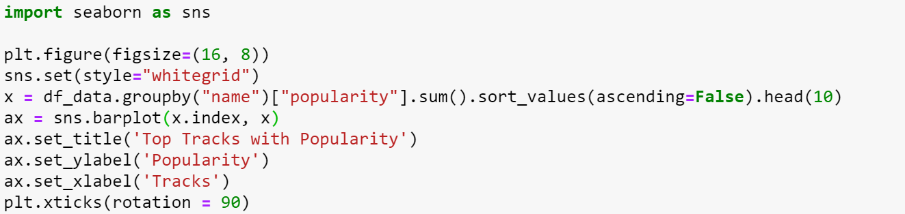
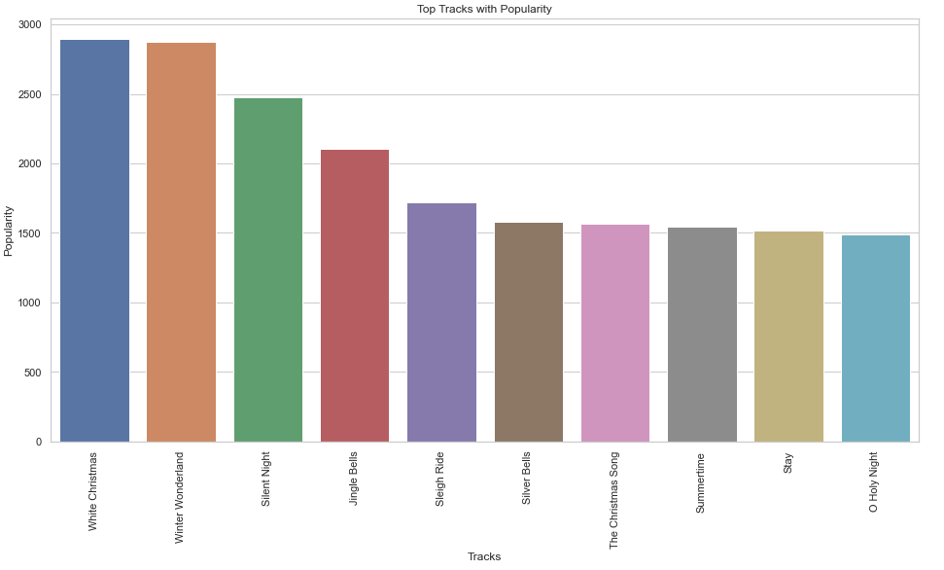
Top 10 Popular Tracks
Most popular tracks are usually holiday songs like White Christmas, Winter Wonderland , Silent Night

Slide 11
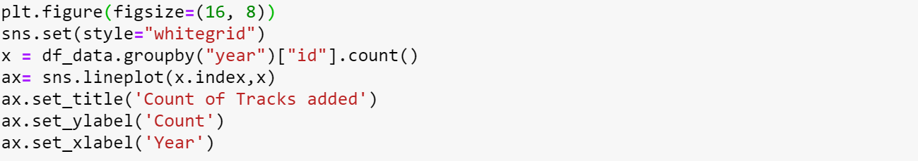
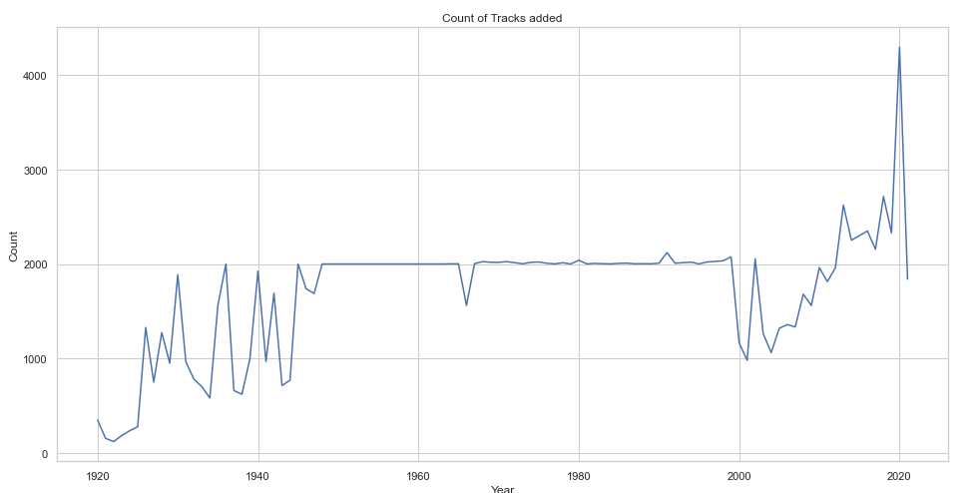
Count of Tracks added over the years
The earliest song in the database is from 1920s
Number of songs in the database from 1950 - 2000 remain constant
Number of songs keep on increasing in the later year

Slide 12
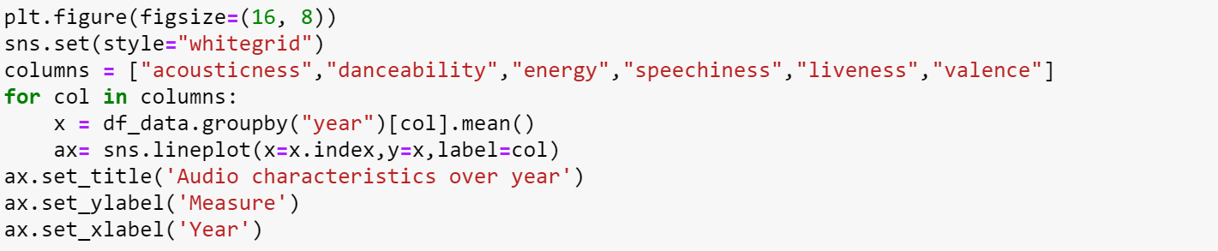
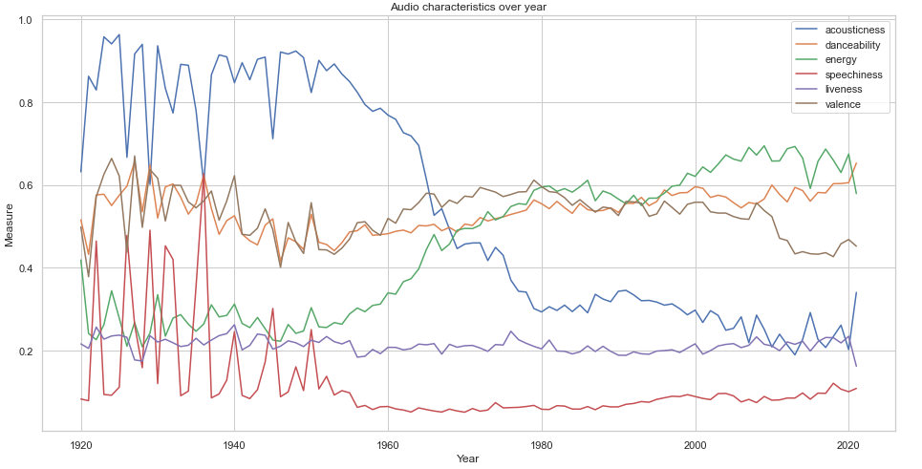
Audio Characteristics over years
The acousticness of the songs have been decreasing with time
The energy of songs have been on constant rise throughout the year
It can be seen songs in 1920-1940 were heavy on words, as we see the trend in speechiness. Post 1960, this has remained some what constant
Liveness of the songs has remained constant throughout the years
Danceability has also been constant throughout the years

Slide 13
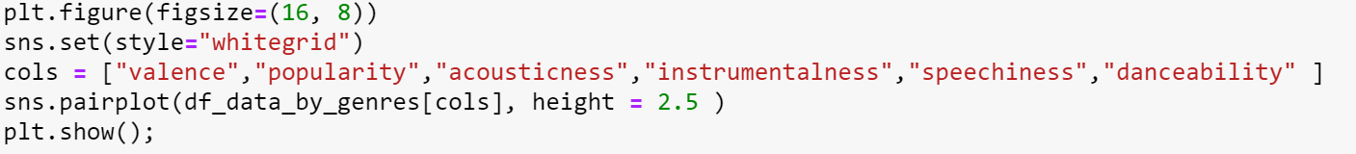
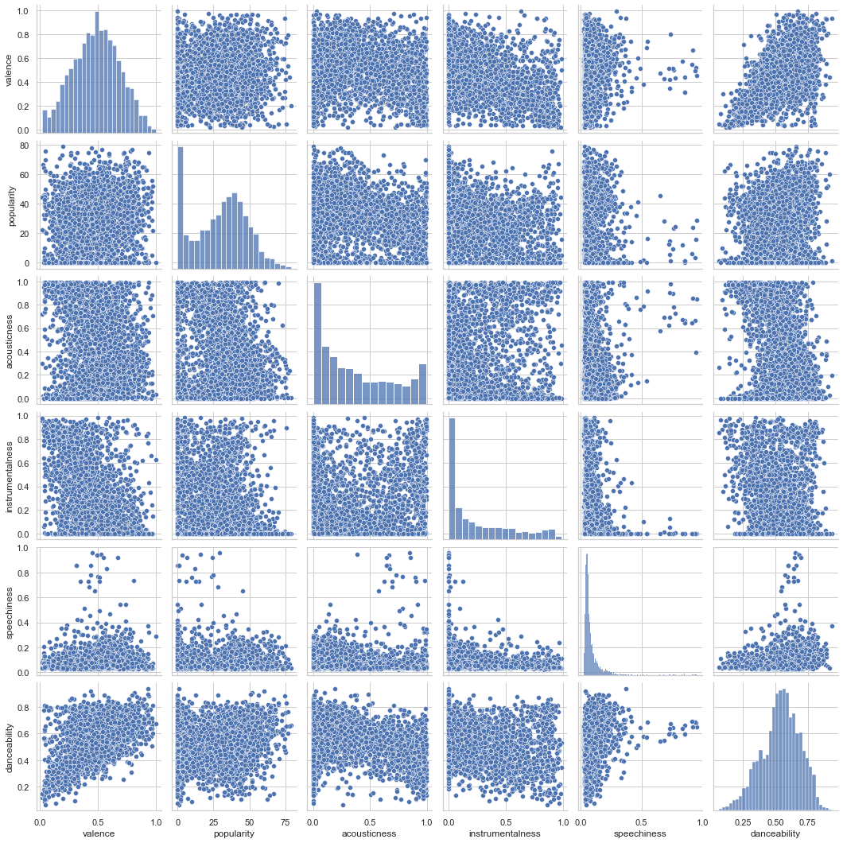
Popularity of Genres with respect to various features
Valence and Danceability are highly related
Danceability and Speechiness are also highly related
Songs with low speechiness usually have high valence (Positiveness of the track )

Slide 14
Exploratory Data Analysis
Song Prediction System
Q&A

Slide 15
Song Popularity Prediction Analysis
We will now proceed with developing a model and predicting the popularity rating of a song
Importing the libraries and Data Cleaning
Input Data Characteristics wrt to Target Variable
Model construction
Model fine-tuning
Output

Slide 16
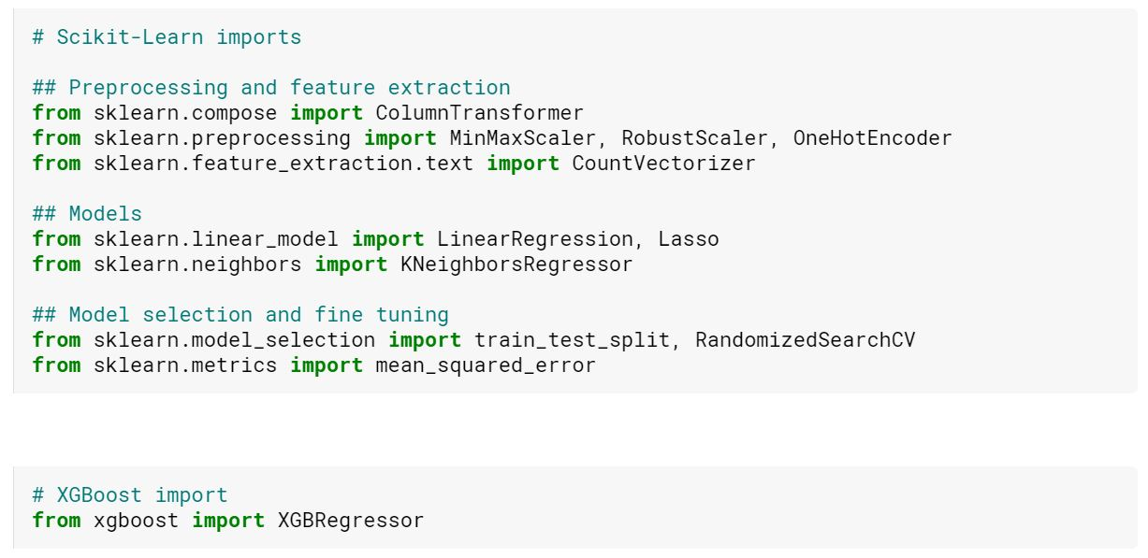
Importing the libraries
We begin by importing scikit library. Scikit-learn (also known as sklearn) is a free software machine learning library for the Python programming language It features various classification, regression and clustering algorithms, which will be used in our prediction system.

Slide 17
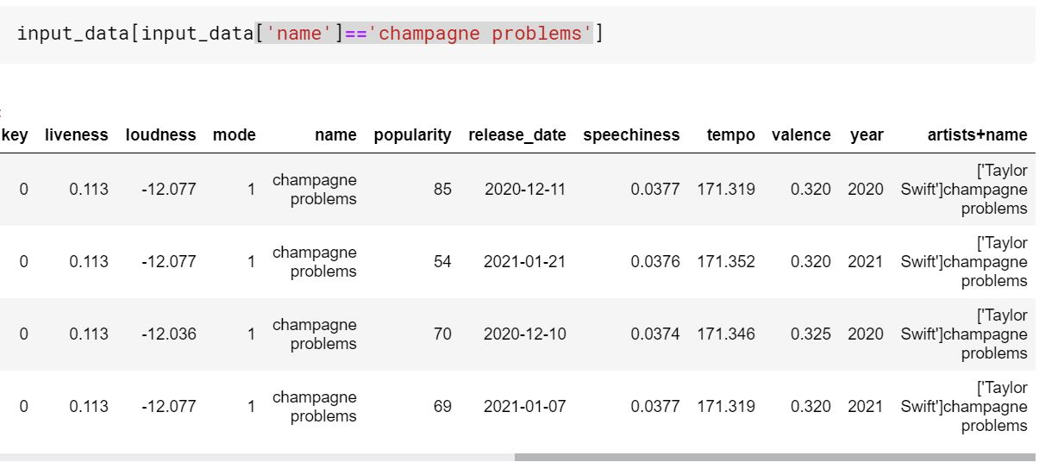
Analysis on Duplicate Records

Slide 18
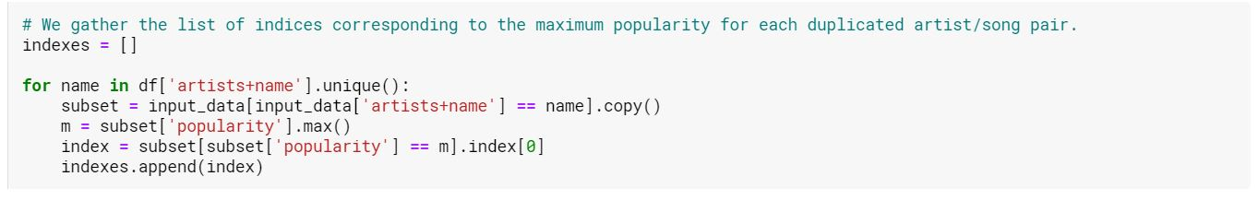
Removing Duplicate Records

Slide 19
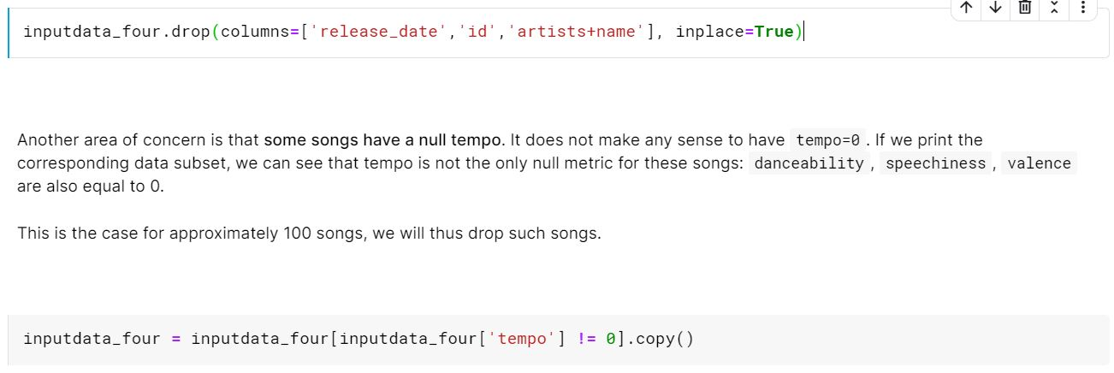
Dropping Unnecessary Columns

Slide 20
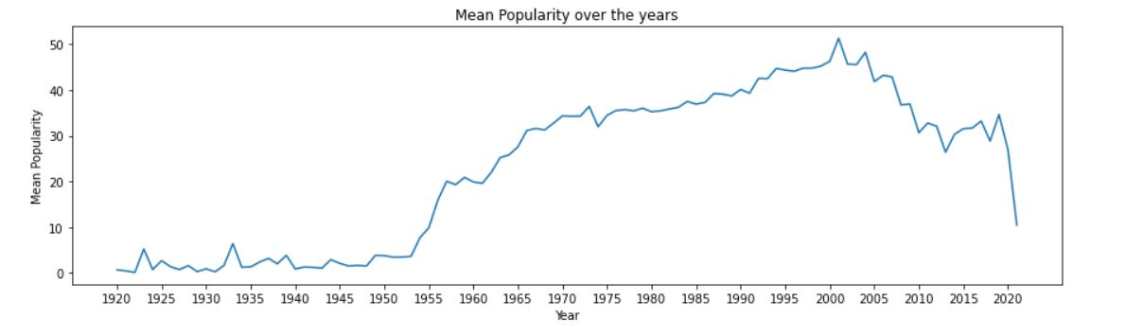
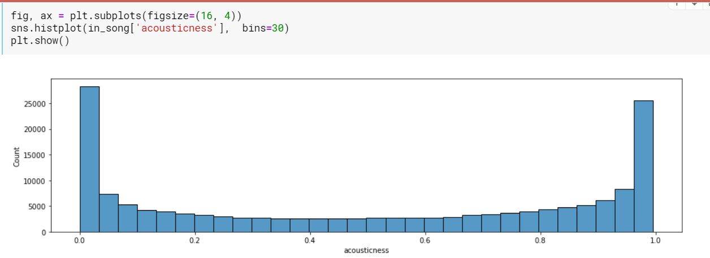
Input Data vs Target

Slide 21
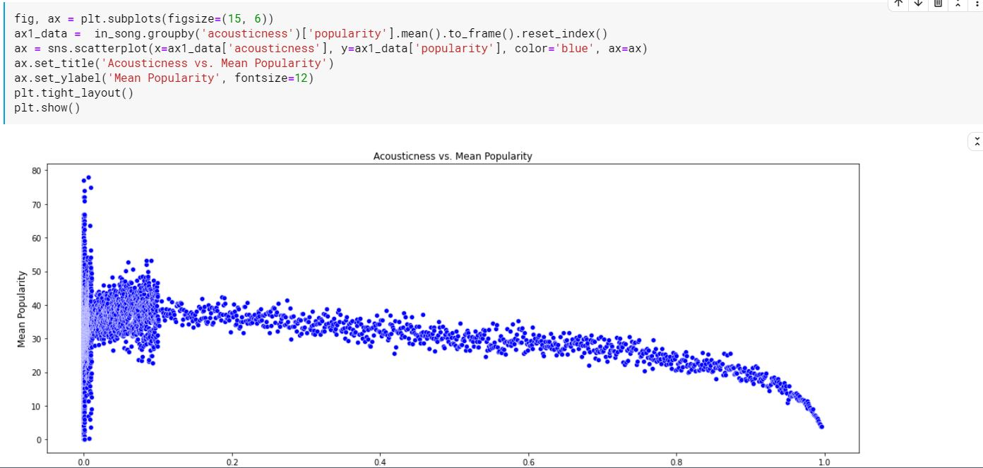
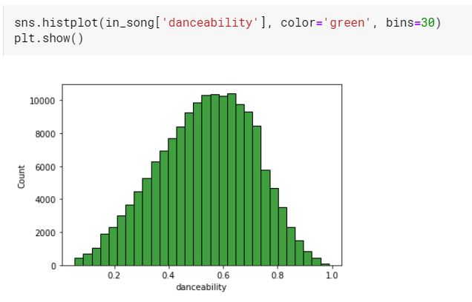
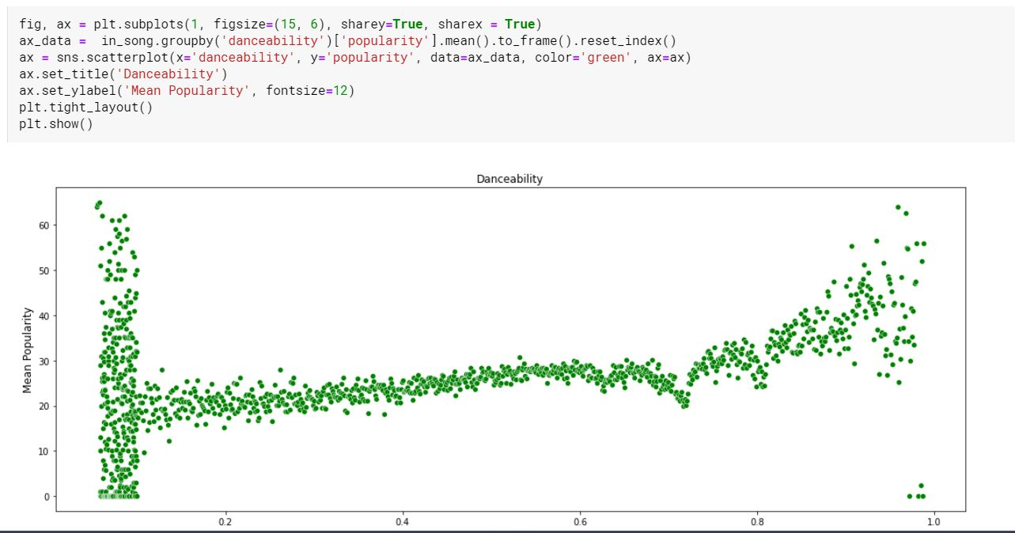

Slide 22
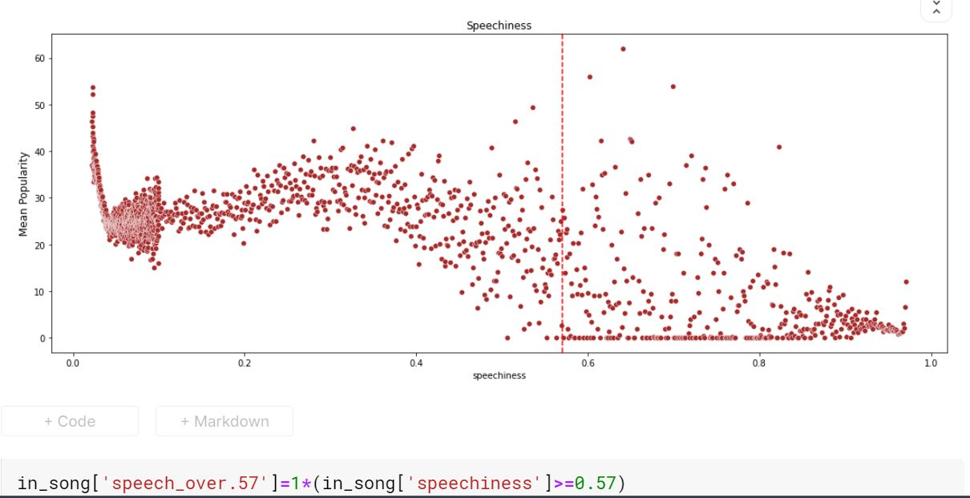
Numerical to Binary Variables

Slide 23
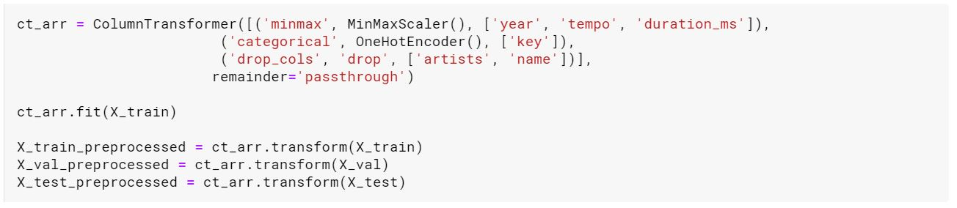
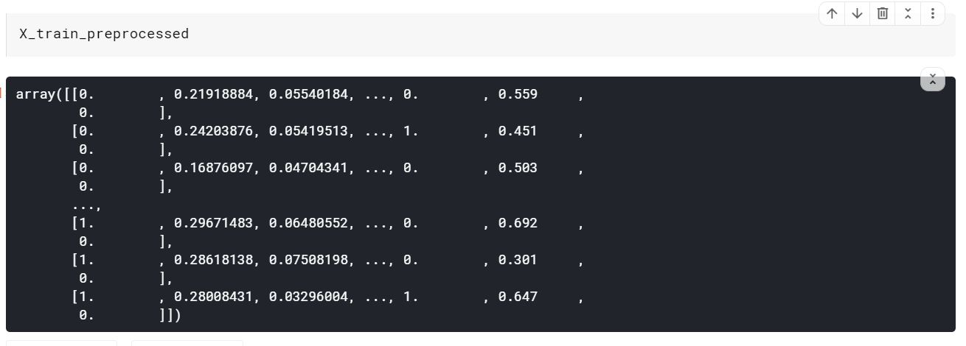
Column Transformer

Slide 24
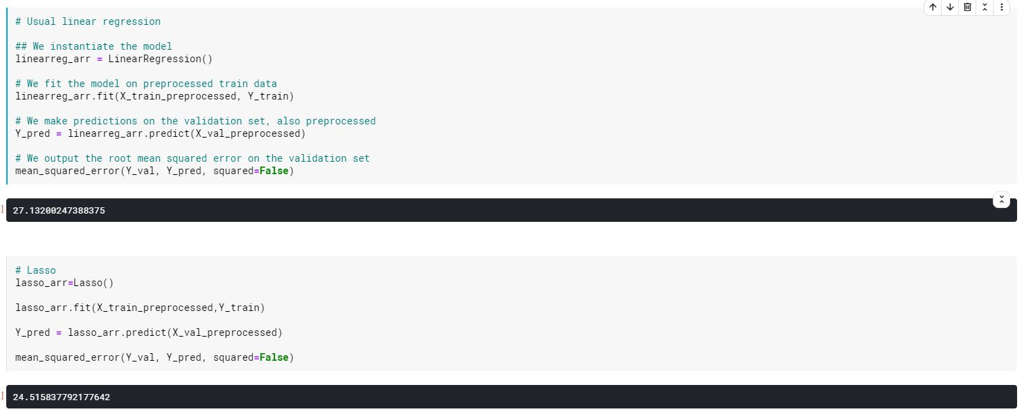
Model Selection & Analysis

Slide 25
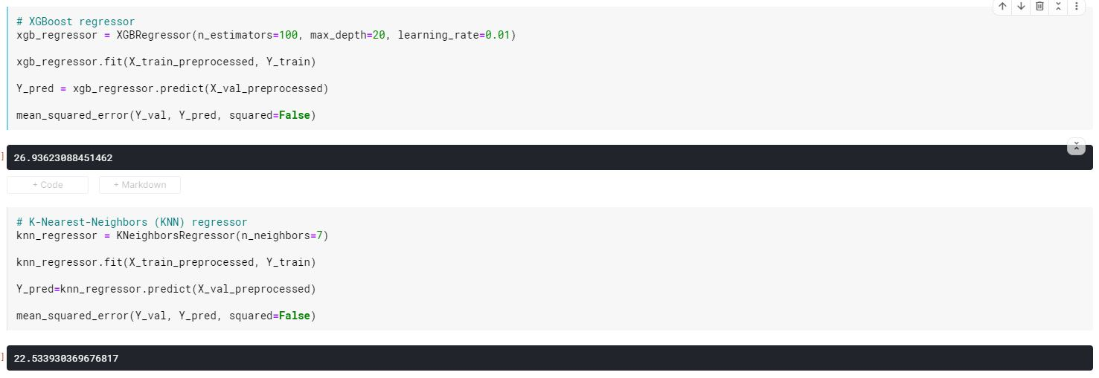
Model Selection & Analysis

Slide 26
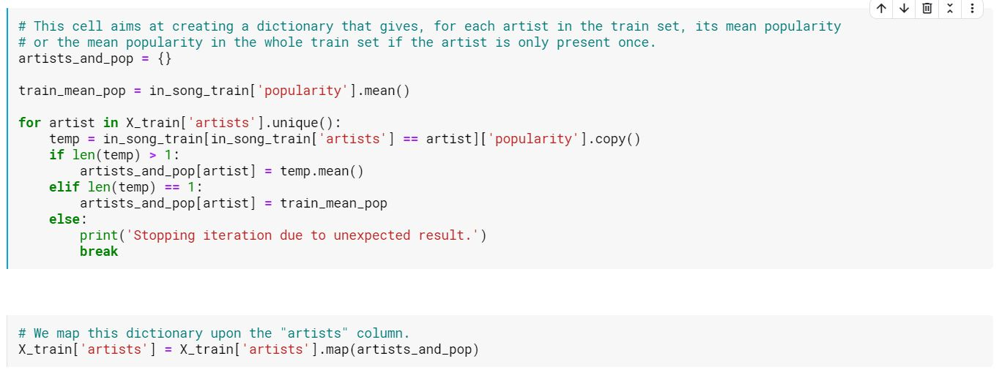
Model Fine-Tuning

Slide 27
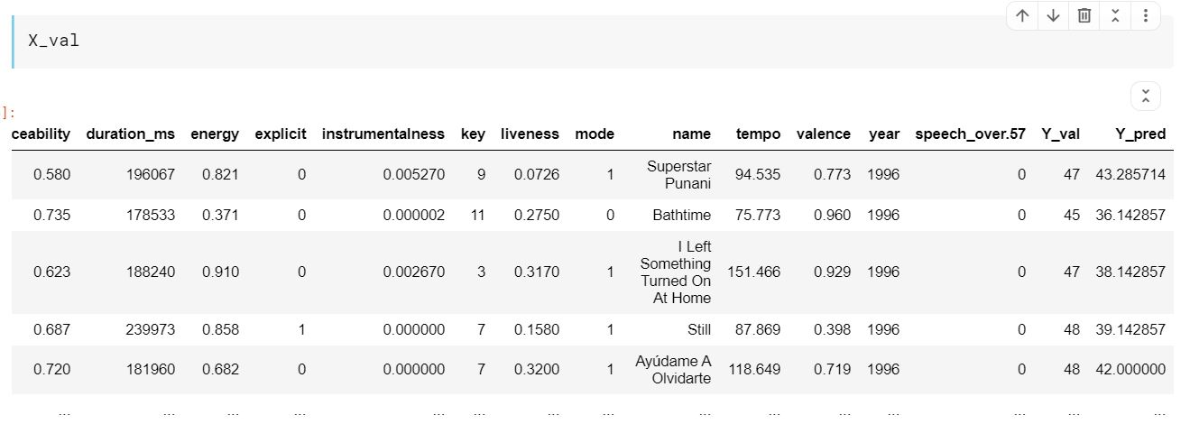
Predicted Vs Actual

Slide 28
Feature Importance & Recommendation
Feature Name | Coefficient
Artist | 39.19
Year | 26.62
Duration | 4.27
Danceability | 2.96
Tempo | 0.49
Feature Name | Coefficient
Key(11) | -0.20
Instrumentalness | -1.12
Explicit | -1.23
Acousticness | -2.74

Slide 29
Exploratory Data Analysis
Song Prediction System
Q&A

